Slide 1
“Covenant Breakers”
Matthew 5:27-37
Meeting Jesus in Matthew:
What Does Jesus Teach?
1/23/2016

Slide 3
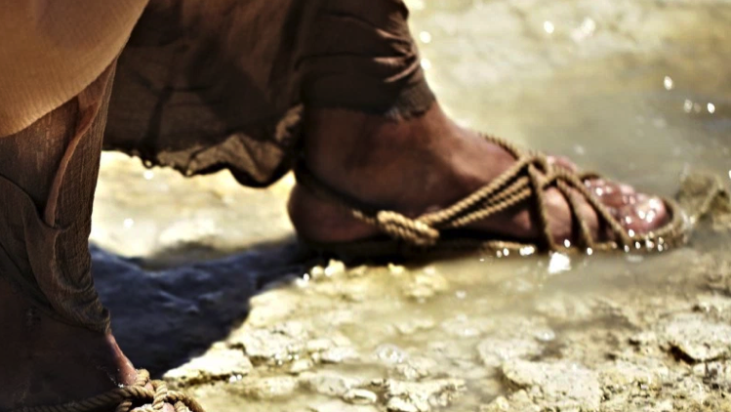

Slide 4
Jesus directly confronts our relational sins

Slide 5
Adultery
Matthew 5:27
You have heard that it was said, ‘You shall not commit adultery.’

Slide 6
Divorce
Matthew 5:31
It has been said, ‘Anyone who divorces his wife must give her a certificate of divorce.’

Slide 7
Oath-Breaking
Matthew 5:33
Again, you have heard that it was said to the people long ago, ‘Do not break your oath, but fulfill to the Lord the vows you have made.’

Slide 9
Jesus directly confronts our relational sins
Jesus intensifies the standard

Slide 10
Adultery ➔ Lust
Matthew 5:28
But I tell you that anyone who looks at a woman lustfully has already committed adultery with her in his heart.

Slide 11
Divorce ➔ Covenant Breaking
Matthew 5:32
But I tell you that anyone who divorces his wife, except for sexual immorality, makes her the victim of adultery, and anyone who marries a divorced woman commits adultery.

Slide 12
Oath-Breaking ➔ Habitual Lying
Matthew 5:34-37
But I tell you, do not swear an oath at all: either by heaven, for it is God’s throne; or by the earth, for it is his footstool; or by Jerusalem, for it is the city of the Great King.
And do not swear by your head, for you cannot make even one hair white or black. All you need to say is simply ‘Yes’ or ‘No’; anything beyond this comes from the evil one.

Slide 14
Jesus directly confronts our relational sins
Jesus intensifies the standard
Jesus expects real change in our lives

Slide 15
Fighting Against Sin
Matthew 5:29-30
If your right eye causes you to stumble, gouge it out and throw it away. It is better for you to lose one part of your body than for your whole body to be thrown into hell.
And if your right hand causes you to stumble, cut it off and throw it away. It is better for you to lose one part of your body than for your whole body to go into hell.

Slide 16
Not Just Resisting Lust
Matthew 5:20
For I tell you that unless your righteousness surpasses that of the Pharisees and the teachers of the law, you will certainly not enter the kingdom of heaven.

Slide 17
Holy Perfection
Matthew 5:48
Be perfect, therefore, as your heavenly Father is perfect.

Slide 18
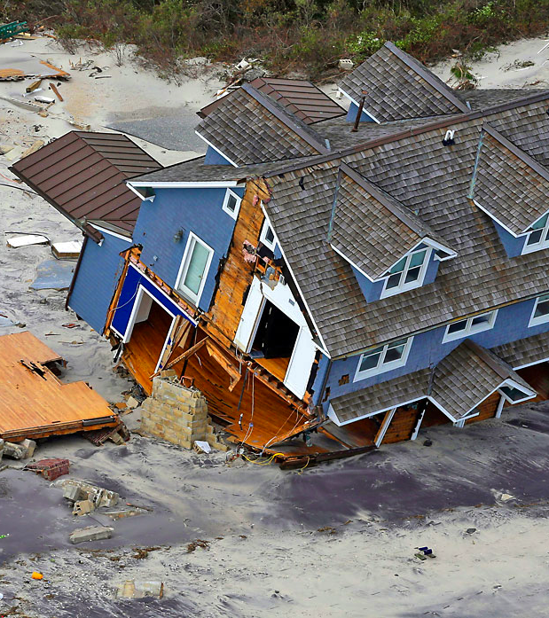
Practicing Righteousness
Matthew 7:
v24: Therefore everyone who hears these words of mine and puts them into practice is like a wise man who built his house on the rock.
v26: But everyone who hears these words of mine and does not put them into practice is like a foolish man who built his house on sand.

Slide 19
Jesus directly confronts our relational sins
Jesus intensifies the standard
Jesus expects real change in our lives
There is good news in the Gospel of Jesus

Slide 20
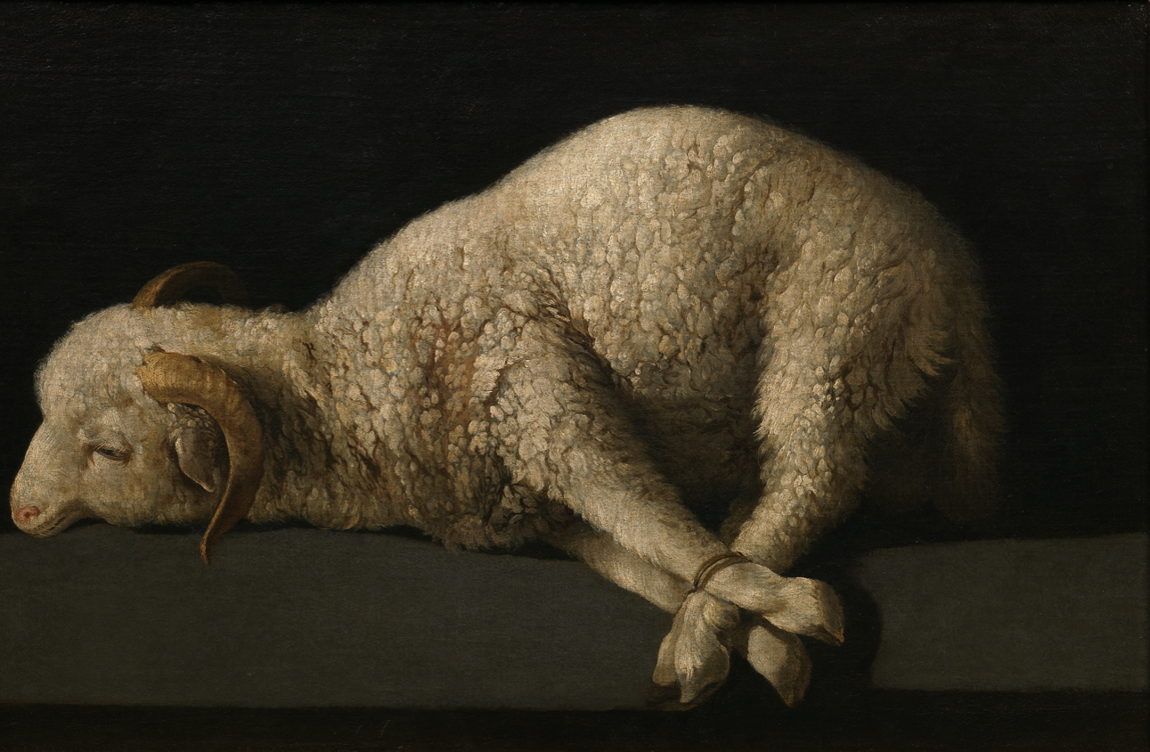
2 Corinthians 5:21
God made him who had no sin to be sin for us, so that in him we might become the righteousness of God.

Slide 21
Colossians 2:13-14a
When you were dead in your sins and in the uncircumcision of your flesh, God made you alive with Christ.
He forgave us all our sins, having canceled the charge of our legal indebtedness, which stood against us and condemned us;

Slide 22
He has taken it away, nailing it to the cross.
Colossians 2:14b

Slide 23
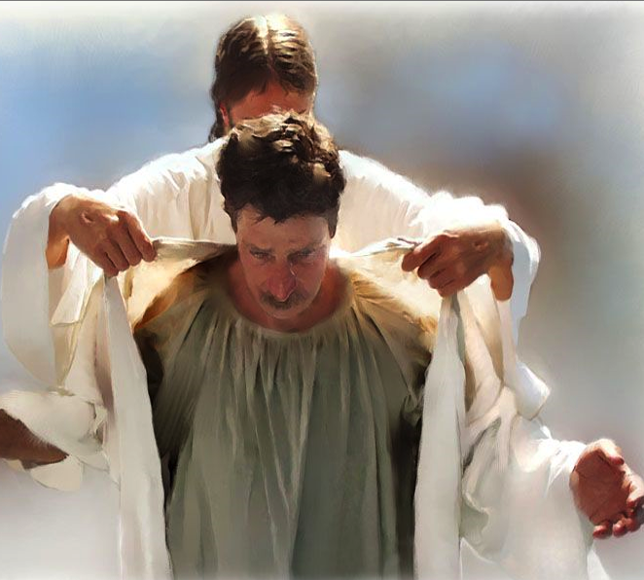
Romans 3:22
This righteousness is given through faith in Jesus Christ to all who believe.

Slide 25
Ezekiel 36:26-27
I will give you a new heart and put a new spirit in you; I will remove from you your heart of stone and give you a heart of flesh. And I will put my Spirit in you and move you to follow my decrees and be careful to keep my laws.

Slide 27
Jesus Transforms his Disciples from Covenant-Breakers into Covenant-Keepers.

Slide 28
Jesus Transforms his Disciples from Covenant-Breakers into Covenant-Keepers.
The Life of the Christian is Becoming Who God Already Declares Us to Be.

