Slide 1
Cornerstone Church Covenant
Anthony J. Courtemanche
6/11/2016

Slide 2
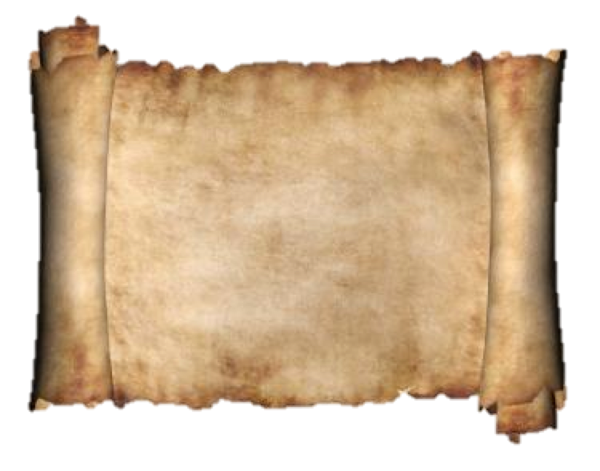
Definitions (1 of 2)
A covenant is “an agreement or mutual obligation, contracted deliberately and with solemnity”
  Schaff-Herzog Encyclopedia, vol. 1, p. 562.
We agree…

Slide 3
Definitions (2 of 2)
“The church covenant is a declaration, which some churches draw up and call their members to sign, in which their duties as church members towards God and their fellow believers are outlined.
  It is a fraternal agreement, freely endorsed, that establishes what are, according to the Holy Scriptures, the duties of a Christian and the responsibilities which each church member pledges himself or herself to honor, in the best way possible.”
  https://en.wikipedia.org/wiki/Church_covenant
We agree…

Slide 4
Some Helpful Resources
http://www.desiringgod.org/messages/why-a-church-covenant
https://9marks.org/article/membership-matters-what-our-church-covenant/

Slide 5
A Historical Example
In 1649 in Cambridge, Massachusetts, John Cotton, Richard Mather, and Ralph Partridge drew up a “model of church government” which reasoned like this:
  God wills for his people to gather in visible local churches (Revelation 2-3)
  But, this visible union with a local church is not established by:
    Mere "faith”
    A “bare” profession of faith
    Living in the same community
    Baptism
Instead, what establishes the visible union of a group of believers into a church is that they make a covenant with each other to be the church

Slide 6
Marks of a Church Covenant (1 of 2)
A church covenant is a promise
  A promise made to God, to a local church, and to one’s self
A church covenant is a summary of how we agree to live, or how God would have us live
  As compared to our articles of faith, which is a summary of what we believe
A church covenant is a sign of commitment
  A commitment to God, to His church, to each other, and to personal holiness

Slide 7
Marks of a Church Covenant (2 of 2)
A church covenant is an ethical statement
  Church membership involves being held accountable to live every aspect of our lives in a manner consistent with a common understanding of Scripture
A church covenant is a biblical standard
  A church covenant is helpful in a church that is practicing Biblical church discipline
  As members of a church, we exhort one another to live holy lives, and we challenge brothers and sisters persisting in sin

Slide 8
Goals of the Cornerstone Church Covenant
Similar in tone and style with our other documents:
  Simple but precise language
  Intended to be understandable today

Slide 9
Cornerstone Covenant (1 of 6)
God brought me to Cornerstone to believe the gospel, mature as a follower of Jesus, love His church, and join His mission. I fully agree with Cornerstone’s Articles of Faith and commit to Cornerstone’s unique calling and expression as explained in our Vision, Mission, Core Values, Philosophy of Ministry, and By-Laws.

Slide 10
Cornerstone Covenant (2 of 6)
I submit myself to the leadership, discipleship, and discipline of the Elders, and the mutual accountability of fellow brothers and sisters in Christ at Cornerstone. As a follower of Jesus, and a member of our church, I promise to:

Slide 11
Cornerstone Covenant (3 of 6)
  Love God by regularly reading and studying the Bible, praying, seeking to obey Jesus’ commands, asking for the Holy Spirit’s active presence in my life, faithfully attending worship services, taking the Lord’s Supper, and by giving tithes and offerings of my money and time to Cornerstone;

Slide 12
Cornerstone Covenant (4 of 6)
  Love God’s People by regularly participating in small groups, attending members meetings, using my gifts and talents for the church’s benefit, being quick to forgive and receive forgiveness, encouraging one another, and protecting the unity of the church;

Slide 13
Cornerstone Covenant (5 of 6)
  Love God’s Mission by building friendships with unsaved neighbors, coworkers, and family members, praying for them, sharing the gospel, inviting the unchurched to Cornerstone, welcoming first-time guests in as new friends, and supporting the work of reaching the lost around the world.

Slide 14
Cornerstone Covenant (6 of 6)
If one day I leave Cornerstone, I promise to join a like-minded church that believes the gospel and joins God in His mission to make, mature, and multiply followers of Jesus.

Slide 15
A gospel-centered church that changes lives…
…through sharing the message of Jesus Christ in word and deed
To make, mature, and multiply followers of Jesus

