Slide 1
Pastor’s Report
Vision, Mission, Values Review
2016.06.11 Practice Business Meeting

Slide 2
A gospel-centered church that changes lives through sharing the message of Jesus Christ in word and deed
Vision
(What we want to become and accomplish)

Slide 3
What is the gospel?
1 Corinthians 15:3-4 For I delivered to you as of first importance what I also received, that Christ died for our sins according to the Scriptures, and that He was buried, and that He was raised on the third day according to the Scriptures, (NIV®)
2 Corinthians 5:21 He made Him who knew no sin to be sin on our behalf, so that we might become the righteousness of God in Him. (NIV®)

Slide 4
What is the gospel?
The gospel is the good news that Jesus lived a perfect life, died an innocent death, rose again so that we may spend eternity with him, and now credits us with his holy record so that we may enjoy a guilt-free life today.

Slide 5
How are we becoming a gospel-centered church?
Evangelism introducing Jesus
Connections around Christ
Worship centering on Christ
Preaching pointing to Christ
How are you becoming gospel-centered?

Slide 6
Is Jesus changing lives?
+1 gospel-centered church in Westford
38 worship services
196+ first-time guests
98 regular attenders
64~ attendance since Jan
20 faith stories
3 semesters of small groups (8 groups)
2 intro to Jesus classes
Two conversions
Two baptisms
Westford outreach

Slide 7
More lives to be changed…
John 4:35 Don't you have a saying, 'It's still four months until harvest'? I tell you, open your eyes and look at the fields! They are ripe for harvest.(NIV®)
John 10:16 I have other sheep that are not of this sheep pen. I must bring them also. They too will listen to my voice, and there shall be one flock and one shepherd.(NIV®)

Slide 8
To make, mature, and multiply followers of Jesus
Mission
(How we carry out our vision)

Slide 9
Then Jesus came to them and said, “All authority in heaven and on earth has been given to me. Therefore go and make disciples of all nations, baptizing them in the name of the Father and of the Son and of the Holy Spirit, and teaching them to obey everything I have commanded you. And surely I am with you always, to the very end of the age.” (NIV®)
Matthew 28:18-20

Slide 10
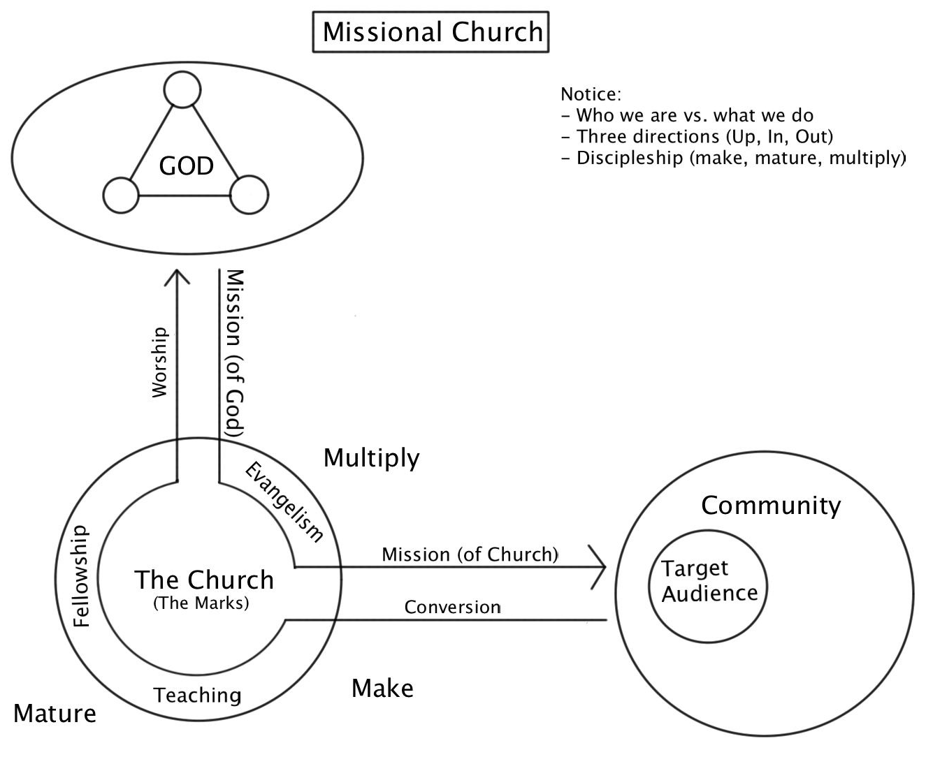

Slide 11
Target Audience
Our target audience is families with children, specifically children 13 and below, with parents generally 28-45 years old, with an emphasis on reaching the unchurched through the design of our programs and outreach.
This equals ~36% of the population of Westford.

Slide 12
Make, Mature, Multiply
Make: What do you believe about Jesus?
Savior, king, faith story, gospel every-day
Mature: How are you growing as a follower of Jesus?
Small groups, ministry teams, personal study/prayer
Multiply: How are you making new followers of Jesus?
Invitational church, outreach, frontline

Slide 13
Bible
Community
Discipleship
Love
Outreach
Prayer
Core Values
(The primary characteristics and DNA of who we are)

Slide 14
We study, preach, apply, and share God’s Word.
2 Timothy 3:16-17
Bible

Slide 15
We gather together to worship God and welcome new friends.
Acts 2:42-47
Community

Slide 16
We learn to love and obey Jesus and help others do the same.
Matthew 28:18-20
Discipleship

Slide 17
We receive and share God’s love and grace because Jesus first loved us.
John 13:34-35
Love

Slide 18
We serve others and share the gospel.
Jeremiah 29:7, Acts 1:8
Outreach

Slide 19
We invite God to work in our lives, church, and town.
Romans 8:26
Prayer

Slide 20
3 Ways To Pray
Lives — Pray for energy, engagement, & growth
Church — Pray for Cornerstone & Immanuel
Town — Pray for Westford & Top 10 Most Wanted

Slide 21
Thank You!
Calling me your pastor
Serving with me
Loving my family
Praying for us
Reminding me of gospel
God is on the move!

