Slide 1
Grace and Forgiveness
Givers and Receivers of GRACE
Genesis 50:15-21

Slide 2
Grace and Forgiveness
RECEIVING GRACE & FORGIVENESS
  How can we RECEIVE GRACE & FORGIVENESS as Joseph’s BROTHERs did?
GIVING GRACE & FORGIVENESS
  How can we GIVE GRACE & FORGIVENESS in the way JOSEPH did?

Slide 3
Grace and Forgiveness
“⁸ The LORD is compassionate and gracious, slow to anger, abounding in love. ⁹ He will not always accuse, nor will he harbor his anger forever; ¹⁰ he does not treat us as our sins deserve or repay us according to our iniquities. ¹¹ For as high as the heavens are above the earth, so great is his love for those who fear him; ¹² as far as the east is from the west, so far has he removed our transgressions from us.”
Psalm 103:8-12

Slide 4
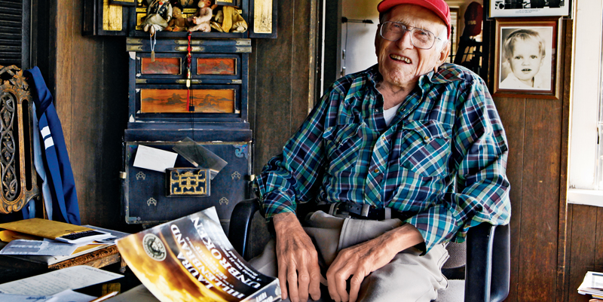
Grace and Forgiveness
Louie Zamperini: The Power of Forgiveness | Guideposts Magazine

Slide 5
Grace and Forgiveness
We are ALL sinners
  In need of receiving GRACE & FORGIVENESS,
  and
  Called to give GRACE & FORGIVENESS to other sinners.

Slide 6
Grace and Forgiveness
“²⁰ Now to him who is able to do immeasurably more than all we ask or imagine, according to his power that is at work within us, ²¹ to him be glory in the church and in Christ Jesus throughout all generations, for ever and ever! Amen. “
Ephesians 3:20-21

