Slide 1
Singing at the Sea
Joining Israel’s Song of Salvation and Hope
Exodus 15:1–18

Slide 2
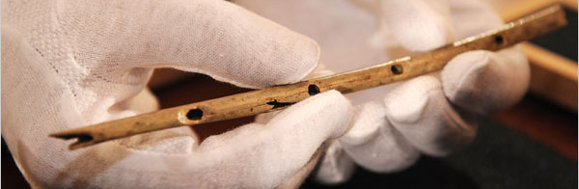
Griffon Vulture Flute from Hohle Fels Cave
Photo from John Noble Wilford, “Flutes Offer Clues to Stone-Age Music,” The New York Times, 24 June 2009. Accessed 10 February 2017.

Slide 3
Singing about the God of the Exodus (vv. 1–12)

Slide 4
Singing about the God of the Exodus (vv. 1–12)
The LORD is a warrior who delivers his people…

Slide 5
Singing about the God of the Exodus (vv. 1–12)
The LORD is a warrior who delivers his people…
So let us trust in him.

Slide 6
Psalm 46:10–11
10 He says, “Be still, and know that I am God;
I will be exalted among the nations,
I will be exalted in the earth.”
11 The LORD Almighty is with us;
the God of Jacob is our fortress.

Slide 7
Singing about the God of the Exodus (vv. 1–12)
The LORD is a warrior who delivers his people…
So let us trust in him.
The LORD is a warrior who destroys his enemies…

Slide 8
Singing about the God of the Exodus (vv. 1–12)
The LORD is a warrior who delivers his people…
So let us trust in him.
The LORD is a warrior who destroys his enemies…
So let us tremble before him.

Slide 9
Exodus 14:30–31
30 That day the LORD saved Israel from the hands of the Egyptians, and Israel saw the Egyptians lying dead on the shore. 31 And when the Israelites saw the mighty hand of the LORD displayed against the Egyptians, the people feared the LORD and put their trust in him and in Moses his servant.

Slide 10
Singing about the God of the Exodus (vv. 1–12)
The LORD is a warrior who delivers his people…
So let us trust in him.
The LORD is a warrior who destroys his enemies…
So let us tremble before him.

Slide 11
Singing about the Goal of the Exodus (vv. 13–18)

Slide 12
Singing about the Goal of the Exodus (vv. 13–18)
The LORD redeems his people so that he might dwell with them…

Slide 13
Revelation 21:1–3
¹ Then I saw “a new heaven and a new earth,” for the first heaven and the first earth had passed away, and there was no longer any sea. 2 I saw the Holy City, the new Jerusalem, coming down out of heaven from God, prepared as a bride beautifully dressed for her husband. 3 And I heard a loud voice from the throne saying, “Look! God’s dwelling place is now among the people, and he will dwell with them. They will be his people, and God himself will be with them and be their God.

Slide 14
Singing about the Goal of the Exodus (vv. 13–18)
The LORD redeems his people so that he might dwell with them…
So let us long to be with him.

Slide 15
Jeremiah 23:5–7
5 “The days are coming,” declares the LORD,
“when I will raise up for David a righteous Branch,
a King who will reign wisely
and do what is just and right in the land.
6 In his days Judah will be saved
and Israel will live in safety.
This is the name by which he will be called:
The LORD Our Righteous Savior.”
7 “So then, the days are coming,” declares the LORD, “when people will no longer say, ‘As surely as the LORD lives, who brought the Israelites up out of Egypt…’”

