Slide 1
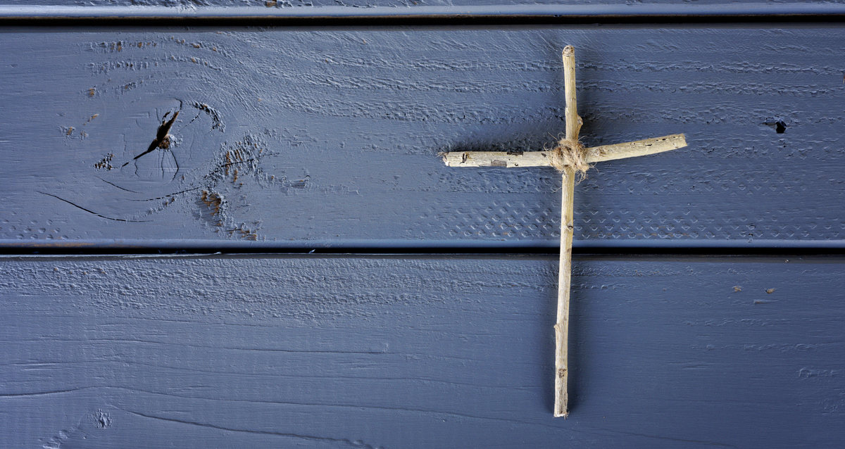
What We Believe Matters
2 Peter 1:19-21
Pic via: lightstock.com

Slide 2
What’s your view of Scripture?
“The Bible is very easy to understand. But we Christians are a bunch of scheming swindlers. We pretend to be unable to understand it because we know very well that the minute we understand, we are obliged to act accordingly.” – Søren Kierkegaard

Slide 3
What’s your view of Scripture?
“A Bible that’s falling apart usually belongs to someone who isn’t.” – Charles H. Spurgeon

Slide 4
What’s your view of Scripture?
“I have been a Christian all these years not because I had the courage to hold on to an embattled view of Scripture, but because I have been held happily captive by the beauty of God and his ways that I see through the Scriptures.” – John Piper

Slide 5
What’s your view of Scripture?
“I believe in Christianity as I believe that the sun has risen: not only because I see it, but because by it I see everything else.” – C. S. Lewis

Slide 6
What’s Cornerstones view of Scripture?
I. The Scriptures
1. We believe that the entirety of the Bible is the Word of God, free from error in the original words (inerrant), authored under the inspiration of the Holy Spirit (God-breathed), fully authoritative in all matters it addresses, incapable of being wrong (infallible), and always accomplishing its purposes.

Slide 7
What’s Cornerstones view of Scripture?
I. The Scriptures
1. We believe that the entirety of the Bible is the Word of God, free from error in the original words (inerrant), authored under the inspiration of the Holy Spirit (God-breathed), fully authoritative in all matters it addresses, incapable of being wrong (infallible), and always accomplishing its purposes.

Slide 8
The Entirety of the Bible
Canon
Old Testament (Jewish Bible)
New Testament

Slide 9
New Testament Authority
“Long ago, at many times and in many ways, God spoke to our fathers by the prophets, but in these last days he has spoken to us by his Son” (Heb. 1:1–2).
“In the beginning was the Word, and the Word was with God, and the Word was God. . . . And the Word became flesh and dwelt among us, and we have seen his glory, glory as of the only Son from the Father, full of grace and truth” (John 1:1, 14).

Slide 10
New Testament Authority
“These things I have spoken to you while I am still with you. But the Helper, the Holy Spirit, whom the Father will send in my name, he will teach you all things and bring to your remembrance all that I have said to you” (John 14:25–26).
“Now we have received not the spirit of the world, but the Spirit who is from God, that we might understand the things freely given us by God. And we impart this in words not taught by human wisdom but taught by the Spirit, interpreting spiritual truths to those who are spiritual” (1 Cor. 2:12–13).

Slide 11
What’s Cornerstones view of Scripture?
I. The Scriptures
1. We believe that the entirety of the Bible is the Word of God, free from error in the original words (inerrant), authored under the inspiration of the Holy Spirit (God-breathed), fully authoritative in all matters it addresses, incapable of being wrong (infallible), and always accomplishing its purposes.

Slide 12
Words Matter
“When Peter saw [John], he said to Jesus, ‘Lord, what about this man?’ Jesus said to him, ‘If it is my will that he remain until I come, what is that to you? You follow me!’ So the saying spread abroad among the brothers that this disciple was not to die; yet Jesus did not say to him that he was not to die, but, ‘If it is my will that he remain until I come, what is that to you?’” (John 21:21–23).

Slide 13
Words Matter
“Do not think that I have come to abolish the Law or the Prophets; I have not come to abolish them but to fulfill them. For truly, I say to you, until heaven and earth pass away, not an iota, not a dot, will pass from the Law until all is accomplished” (Matt. 5:17–18).

Slide 14
Words Matter
“There are some things in [Paul’s letters] that are hard to understand, which the ignorant and unstable twist to their own destruction, as they do the other Scriptures. You therefore, beloved, knowing this beforehand, take care that you are not carried away with the error of lawless people and lose your own stability” (2 Pet. 3:16–17).

Slide 15
Words Matter
“I, Paul, write this greeting with my own hand. This is the sign of genuineness in every letter of mine; it is the way I write” (2 Thess. 3:17).
“I, Paul, write this greeting with my own hand” (1 Cor. 16:21 & Col. 4:18).
“See with what large letters I am writing to you with my own hand” (Gal. 6:11).
“I, Paul, write this with my own hand” (Philem. 19).

Slide 16
Free From Error
We have 5801 Greek Manuscripts of the NT.
Oldest partial manuscript ~ AD 130
Oldest complete manuscript ~ AD 350.
The average work of classic literature has 500 years between the original and the oldest manuscript and has between 2 and 20 copies.

Slide 17
Free From Error
“Fortunately, if the great number of MSS [manuscripts] increases the number of scribal errors, it increases proportionately the means of correcting such errors, so that the margin of doubt left in the process of recovering the exact original wording is not so large as might be feared; it is in truth remarkably small.” – F.F. Bruce

Slide 18
What’s Cornerstones view of Scripture?
I. The Scriptures
1. We believe that the entirety of the Bible is the Word of God, free from error in the original words (inerrant), authored under the inspiration of the Holy Spirit (God-breathed), fully authoritative in all matters it addresses, incapable of being wrong (infallible), and always accomplishing its purposes.

Slide 19
Authored Under the Inspiration of the Holy Spirit
“This is what we speak, not in words taught us by human wisdom but in words taught by the Spirit, explaining spiritual realities with Spirit-taught words” (1 Cor. 2:13).
“For prophecy never had its origin in the human will, but prophets, though human, spoke from God as they were carried along by the Holy Spirit” (2 Pet. 1:21).

Slide 20
What’s Cornerstones view of Scripture?
I. The Scriptures
1. We believe that the entirety of the Bible is the Word of God, free from error in the original words (inerrant), authored under the inspiration of the Holy Spirit (God-breathed), fully authoritative in all matters it addresses, incapable of being wrong (infallible), and always accomplishing its purposes.

Slide 21
Fully Authoritative
“All authority in heaven and on earth has been given to me” (Matt. 28:18b).
“Heaven and earth will pass away, but my words will never pass” (Matt. 24:35).
Jesus’ authority was also noticed by many throughout the New Testament.

Slide 22
Fully Authoritative
Disciple means follower or learner.
Apostle means authorized representative.
“In these days he went out to the mountain to pray, and all night he continued in prayer to God. And when day came, he called his disciples and chose from them twelve, whom he named apostles” (Luke 6:12-13).

Slide 23
What’s Cornerstones view of Scripture?
I. The Scriptures
1. We believe that the entirety of the Bible is the Word of God, free from error in the original words (inerrant), authored under the inspiration of the Holy Spirit (God-breathed), fully authoritative in all matters it addresses, incapable of being wrong (infallible), and always accomplishing its purposes.

Slide 24
Incapable of Being Wrong
“We also have the prophetic message as something completely reliable, and you will do well to pay attention to it, as to a light shining in a dark place, until the day dawns and the morning star rises in your hearts” (2 Peter 1:19).
“The law of the Lord is perfect, refreshing the soul. The statutes of the Lord are trustworthy, making wise the simple” (Psalm 19:7).

Slide 25
What’s Cornerstones view of Scripture?
I. The Scriptures
1. We believe that the entirety of the Bible is the Word of God, free from error in the original words (inerrant), authored under the inspiration of the Holy Spirit (God-breathed), fully authoritative in all matters it addresses, incapable of being wrong (infallible), and always accomplishing its purposes.

Slide 26
Always Accomplishing Its Purposes
so is my word that goes out from my mouth: It will not return to me empty, but will accomplish what I desire and achieve the purpose for which I sent it” (Isaiah 55:11).

Slide 27
What’s Cornerstones view of Scripture?
I. The Scriptures
1. We believe that the entirety of the Bible is the Word of God, free from error in the original words (inerrant), authored under the inspiration of the Holy Spirit (God-breathed), fully authoritative in all matters it addresses, incapable of being wrong (infallible), and always accomplishing its purposes.

Slide 28
Okay, I Believe, Now What?
Hide God’s Word in Your Heart
Right belief results in right living
Increase your view of Scripture and God

Slide 29
Hide God’s Word in Your Heart
“I have hidden your word in my heart that I might not sin against you” (Psalm 119:11).
Jesus used Scripture each of the three times he was tempted by Satan in the wilderness.
“I can do all this through him who gives me strength” (Phil. 4:13).

Slide 30
Right Belief = Right Living
What you believe affects how you live.
Do you believe God has your best in mind?
What about all those hard things in the Bible?

Slide 31
Increase your view of Scripture and God
The more you read and study the Scriptures, the more you see about God’s glory and the truth of Scripture.
Scripture reveals itself.

Slide 32
What’s your view of Scripture?
“I have been a Christian all these years not because I had the courage to hold on to an embattled view of Scripture, but because I have been held happily captive by the beauty of God and his ways that I see through the Scriptures.” – John Piper

