Slide 1
Experiencing the Triune God at Cornerstone
Pic via: lightstock.com

Slide 2
Big Idea: May we strive to understand and experience the Triune God as a church

Slide 3
What is the doctrine of the Trinity?
The Father, Son, and Holy Spirit are distinct persons.

Slide 4
What is the doctrine of the Trinity?
The Father, Son, and Holy Spirit are distinct persons.
Acts 7:55 But Stephen, full of the Holy Spirit, looked up to heaven and saw the glory of God, and Jesus standing at the right hand of God. (NIV®)

Slide 5
What is the doctrine of the Trinity?
The Father, Son, and Holy Spirit are distinct persons.
Each person is fully God.

Slide 6
What is the doctrine of the Trinity?
The Father, Son, and Holy Spirit are distinct persons.
Each person is fully God.
John 1:1 In the beginning was the Word, and the Word was with God, and the Word was God. (NIV®)

Slide 7
What is the doctrine of the Trinity?
The Father, Son, and Holy Spirit are distinct persons.
Each person is fully God.
Acts 5:3–4 Then Peter said, “Ananias, how is it that Satan has so filled your heart that you have lied to the Holy Spirit and have kept for yourself some of the money you received for the land? Didn’t it belong to you before it was sold? And after it was sold, wasn’t the money at your disposal? What made you think of doing such a thing? You have not lied just to human beings but to God.” (NIV®)

Slide 8
What is the doctrine of the Trinity?
The Father, Son, and Holy Spirit are distinct persons.
Each person is fully God.
There is one God.

Slide 9
What is the doctrine of the Trinity?
The Father, Son, and Holy Spirit are distinct persons.
Each person is fully God.
There is one God.
Deuteronomy 6:4–5 Hear, O Israel: The LORD our God, the LORD is one. Love the LORD your God with all your heart and with all your soul and with all your strength.

Slide 10
What is the doctrine of the Trinity?
The Father, Son, and Holy Spirit are distinct persons.
Each person is fully God.
There is one God.
Matthew 28:19 Therefore go and make disciples of all nations, baptizing them in the name of the Father and of the Son and of the Holy Spirit.

Slide 11
Cornerstone Statement of Faith (II.2)
We believe in one God eternally existing in three persons: Father, Son, and Holy Spirit (Trinity).

Slide 12
How should the doctrine of the Trinity transform our church?

Slide 13
Three Dimensions
1D
Line

Slide 14
Three Dimensions
1D | 2D
Line | Many lines make one figure.

Slide 15
Three Dimensions
1D | 2D | 3D
Line | Many lines make one figure. | Many figures make one solid body.

Slide 16
Now the Christian account of God involves just the same principle. The human level is a simple and rather empty level. On the human level one person is one being, and any two persons are two separate beings—just as, in two dimensions (say on a flat sheet of paper) one square is one figure, and any two squares are two separate figures.

Slide 17
On the Divine level you still find personalities; but up there you find them combined in new ways which we, who do not live on that level, cannot imagine. In God’s dimension, so to speak, you find a being who is three Persons while remaining on Being, just as a cube is six squares while remaining one cube. Of course we cannot fully conceive a Being like that; just as, if we were so made that we perceived only two dimensions in space we could never properly imagine a cube.
-C.S. Lewis, Mere Christianity, 133.

Slide 18
How should the doctrine of the Trinity transform our church?
May we be enamored by the greatness of God.

Slide 19
How should the doctrine of the Trinity transform our church?
May we be enamored by the greatness of God.
May we seek intimate relationship with the Triune God.

Slide 20
How should the doctrine of the Trinity transform our church?
May we be enamored by the greatness of God.
May we seek intimate relationship with the Triune God.
John 17:20-21 My prayer is not for them alone. I pray also for those who will believe in me through their message, that all of them may be one, Father, just as you are in me and I am in you. May they also be in us so that the world may believe that you have sent me.

Slide 21
How should the doctrine of the Trinity transform our church?
May we be enamored by the greatness of God.
May we seek intimate relationship with the Triune God.
May we reflect the Trinity by doing life together in love.
John 17:20-21 My prayer is not for them alone. I pray also for those who will believe in me through their message, that all of them may be one, Father, just as you are in me and I am in you. May they also be in us so that the world may believe that you have sent me.

Slide 22
How should the doctrine of the Trinity transform our church?
May we be enamored by the greatness of God.
May we seek intimate relationship with the Triune God.
May we reflect the Trinity by doing life together in love.
John 17:26 I have made you known to them, and will continue to make you known in order that the love you have for me may be in them and that I myself may be in them.

Slide 23
Big Idea: May we strive to understand and experience the Triune God as a church

Slide 24
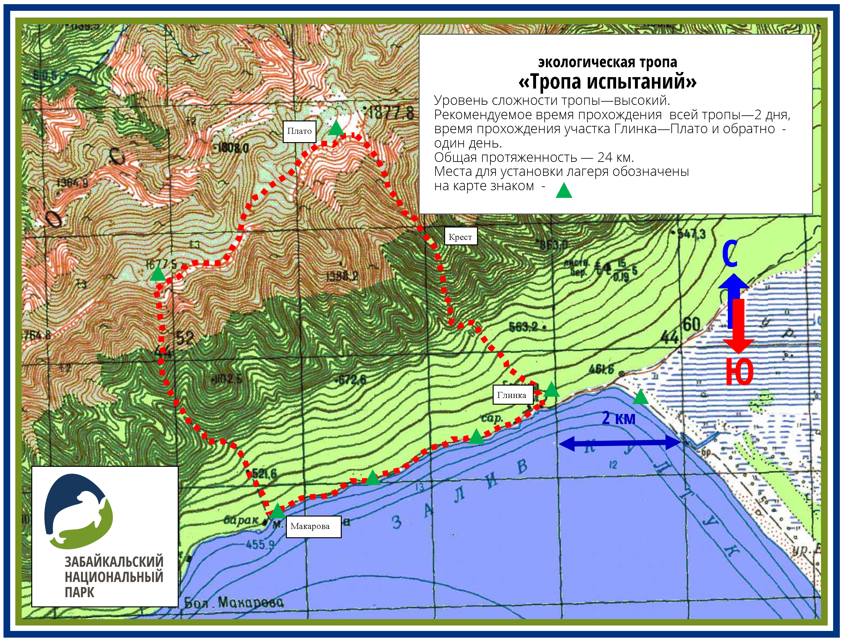
Source: http://zapovednoe-podlemorye.ru/maps/big/

Slide 25
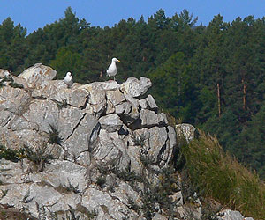
Source: http://www.baikal-raduga.com

