Slide 1
We need grace: Raised to Life Ephesians 2:1-10

Slide 2
We need grace: Raised to Life Ephesians 2:1-10
From what have we been saved?
How have we been saved?
To what have we been saved?

Slide 3
From what have we been saved?
…you were dead in your transgressions and sins, in which you used to live when you followed the ways of this world and of the ruler of the kingdom of the air, the spirit who is now at work in those who are disobedient. All of us also lived among them at one time, gratifying the cravings of our flesh and following its desires and thoughts. Like the rest, we were by nature deserving of wrath. (verses 1-3)

Slide 4
From what have we been saved?
Romans 3:23 for all have sinned and fall short of the glory of God.
Romans 5:12 Therefore, just as sin entered the world through one man, and death through sin, and in this way death came to all people, because all sinned
Romans 8:7-8 The mind governed by the flesh is hostile to God; it does not submit to God’s law, nor can it do so. Those who are in the realm of the flesh cannot please God.

Slide 5
How have we been saved?

Slide 6
How have we been saved?
But because of his great love for us, God, who is rich in mercy, made us alive with Christ even when we were dead in transgressions—it is by grace you have been saved. And God raised us up with Christ and seated us with him in the heavenly realms in Christ Jesus, in order that in the coming ages he might show the incomparable riches of his grace, expressed in his kindness to us in Christ Jesus. For it is by grace you have been saved, through faith—and this is not from yourselves, it is the gift of God— not by works, so that no one can boast. (verses 4-9)

Slide 7
How have we been saved?
But because of his great love for us, God, who is rich in mercy, made us alive with Christ even when we were dead in transgressions—it is by grace you have been saved. And God raised us up with Christ and seated us with him in the heavenly realms in Christ Jesus, in order that in the coming ages he might show the incomparable riches of his grace, expressed in his kindness to us in Christ Jesus. For it is by grace you have been saved, through faith—and this is not from yourselves, it is the gift of God— not by works, so that no one can boast. (verses 4-9)

Slide 8
How have we been saved?
But because of his great love for us, God, who is rich in mercy, made us alive with Christ even when we were dead in transgressions—it is by grace you have been saved. And God raised us up with Christ and seated us with him in the heavenly realms in Christ Jesus, in order that in the coming ages he might show the incomparable riches of his grace, expressed in his kindness to us in Christ Jesus. For it is by grace you have been saved, through faith—and this is not from yourselves, it is the gift of God— not by works, so that no one can boast. (verses 4-9)

Slide 9
How have we been saved?
His Power
Ephesians 1:19-20 …his incomparably great power for us who believe. That power is the same as the mighty strength he exerted when he raised Christ from the dead and seated him at his right hand in the heavenly realms
Ephesians 2:5-6 …made us alive with Christ even when we were dead in transgressions—it is by grace you have been saved. And God raised us up with Christ and seated us with him in the heavenly realms in Christ Jesus

Slide 10
How have we been saved?
But because of his great love for us, God, who is rich in mercy, made us alive with Christ even when we were dead in transgressions—it is by grace you have been saved. And God raised us up with Christ and seated us with him in the heavenly realms in Christ Jesus, in order that in the coming ages he might show the incomparable riches of his grace, expressed in his kindness to us in Christ Jesus. For it is by grace you have been saved, through faith—and this is not from yourselves, it is the gift of God— not by works, so that no one can boast. (verses 4-9)

Slide 11
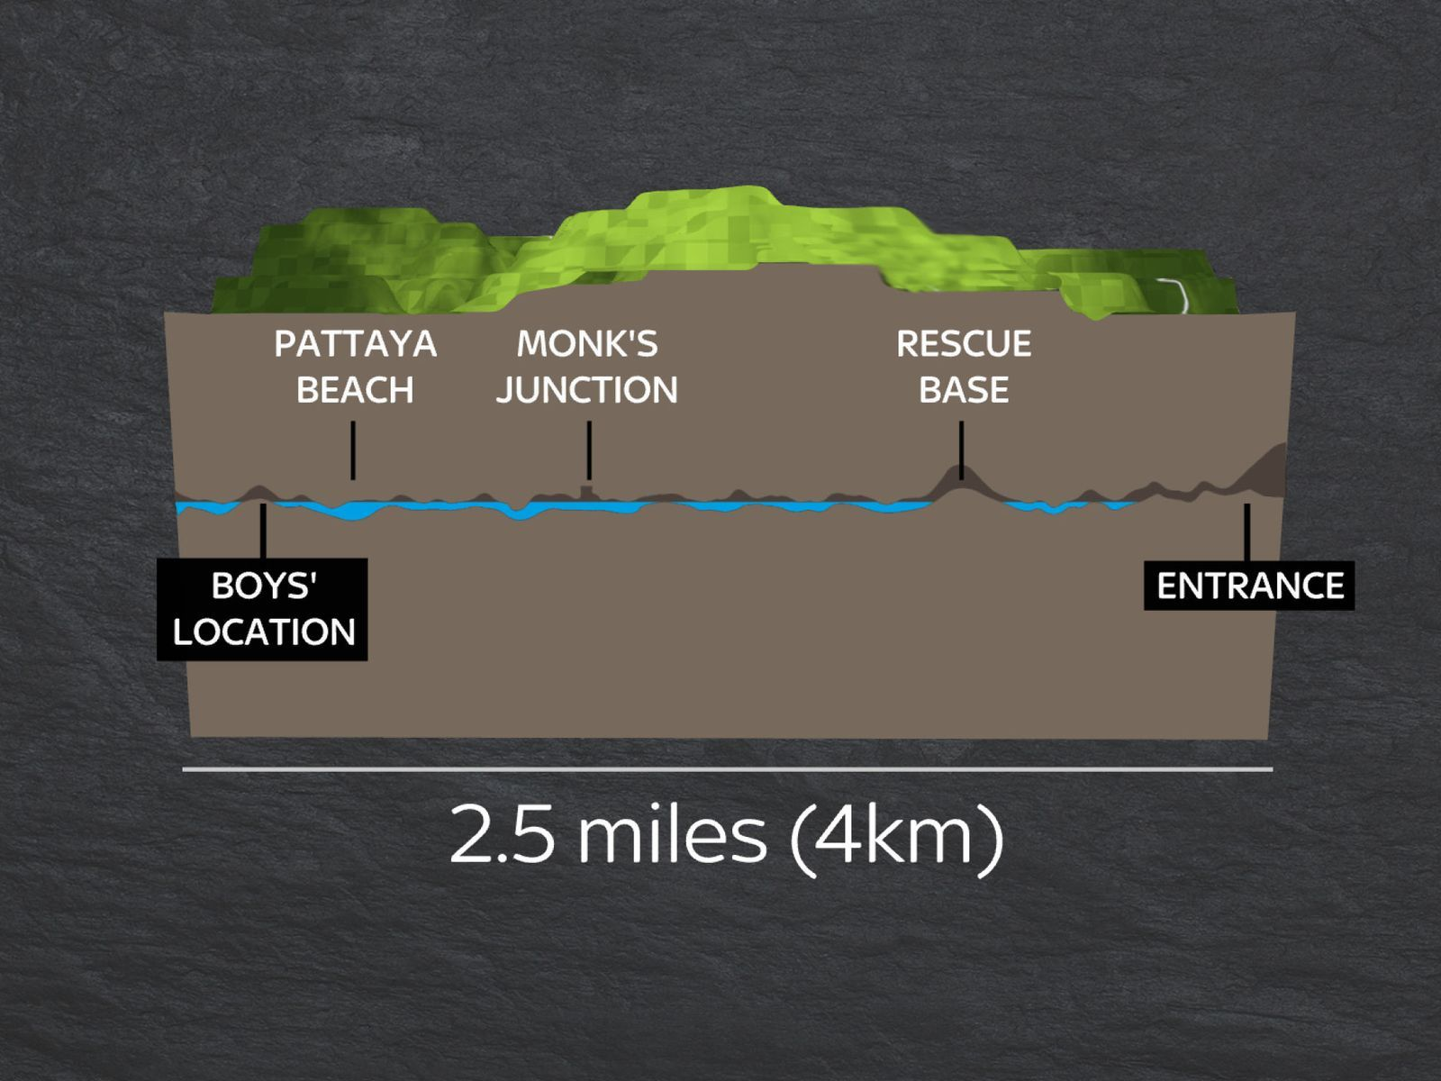

Slide 12
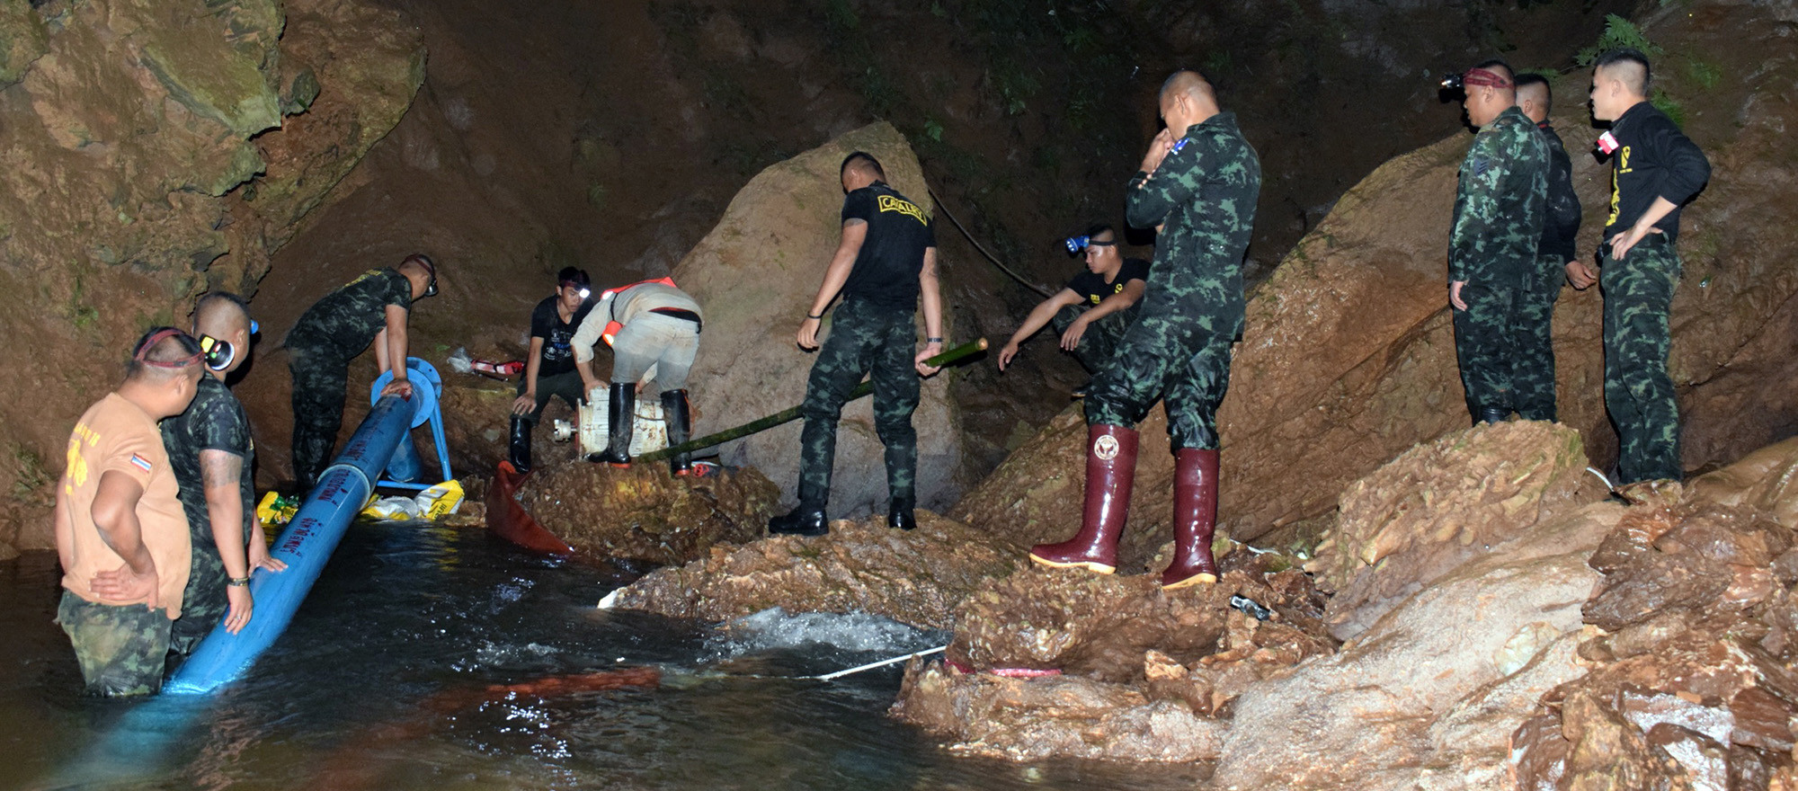
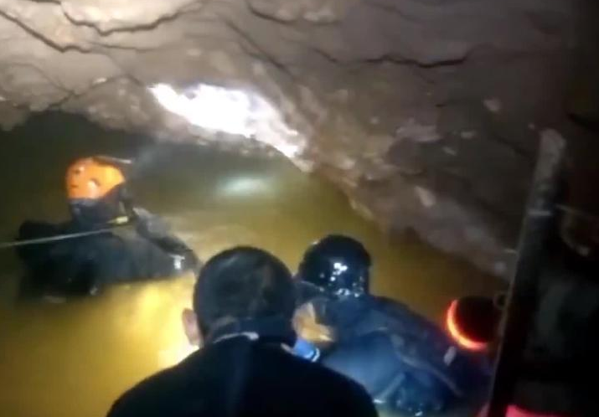
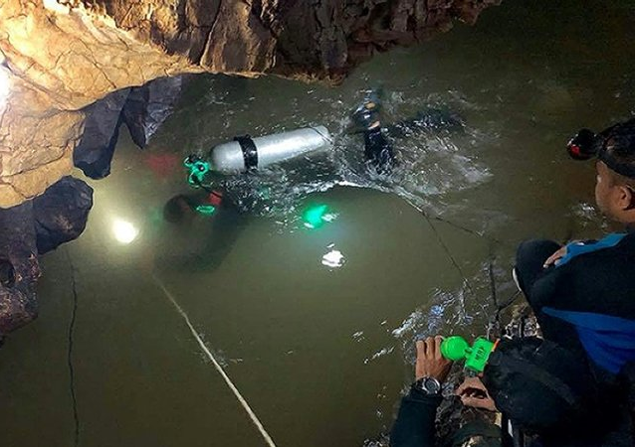

Slide 13
To what have we been saved?

Slide 14
To what have we been saved?
For we are God’s handiwork, created in Christ Jesus to do good works, which God prepared in advance for us to do. (verse 10)

Slide 15
To what have we been saved?
For we are God’s handiwork, created in Christ Jesus to do good works, which God prepared in advance for us to do. (verse 10)
We have been saved to good works.

Slide 16
To what have we been saved?
But because of his great love for us, God, who is rich in mercy, made us alive with Christ even when we were dead in transgressions—it is by grace you have been saved. And God raised us up with Christ and seated us with him in the heavenly realms in Christ Jesus (verses 4-6)

Slide 17
To what have we been saved?
But because of his great love for us, God, who is rich in mercy, made us alive with Christ even when we were dead in transgressions—it is by grace you have been saved. And God raised us up with Christ and seated us with him in the heavenly realms in Christ Jesus (verses 4-6)
We have been saved to relationship with Christ.

Slide 18
To what have we been saved?
1 Peter 3:18 For Christ also suffered once for sins, the righteous for the unrighteous, to bring you to God. He was put to death in the body but made alive in the Spirit.
Colossians 1: 21-22 Once you were alienated from God and were enemies in your minds because of your evil behavior. But now he has reconciled you by Christ’s physical body through death to present you holy in his sight, without blemish and free from accusation

Slide 19
God, because of his love and grace, saved us from sin and death to life, relationship, and good works.

